Slide 1
OGMS Applied
OGMS is the Ontology for General Medical Science, which provides definitions for all the terms (such as ‘disorder’, ‘symptom’, and so forth) See: http://code.google.com/p/ogms/
Axes where PRO can make contributions are, I think, as follows:
Etiological Process
Disorder
Pathological Process
Laboratory Test Result
(Drug) Treatment
Examples of the first 4 are given in slides 3ff.

Slide 2
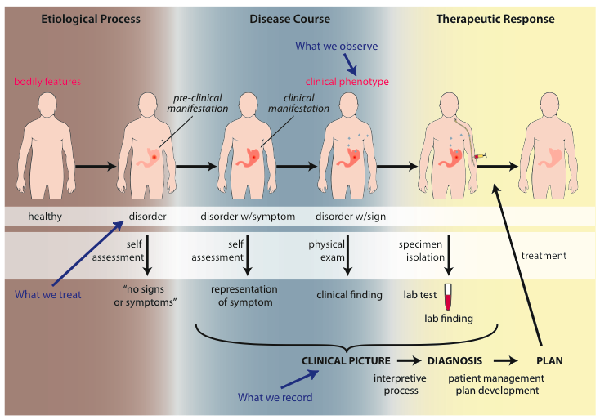
Big Picture

Slide 3
Influenza - infectious
Etiological process - infection of airway epithelial cells with influenza virus
  produces
Disorder - viable cells with influenza virus
  bears
Disposition (disease) - flu
  realized_in
Pathological process - acute inflammation
  produces
Abnormal bodily features
  recognized_as
Symptoms - weakness, dizziness
Signs - fever
Symptoms & Signs
  used_in
Interpretive process
  produces
Hypothesis - rule out influenza
  suggests
Laboratory tests
  produces
Test results - elevated serum antibody titers
  used_in
Interpretive process
  produces
Result - diagnosis that patient X has a disorder that bears the disease flu
But the disorder also induces normal physiological processes (immune response) that can results in the elimination of the disorder (transient disease course).

Slide 4
Huntington’s Disease - genetic
Etiological process - inheritance of >39 CAG repeats in the HTT gene
  produces
Disorder - chromosome 4 with abnormal mHTT
  bears
Disposition (disease) - Huntington’s disease
  realized_in
Pathological process - accumulation of mHTT protein fragments, abnormal transcription regulation, neuronal cell death in striatum
  produces
Abnormal bodily features
  recognized_as
Symptoms - anxiety, depression
Signs - difficulties in speaking and swallowing
Symptoms & Signs
  used_in
Interpretive process
  produces
Hypothesis - rule out Huntington’s
  suggests
Laboratory tests
  produces
Test results - molecular detection of the HTT gene with >39CAG repeats
  used_in
Interpretive process
  produces
Result - diagnosis that patient X has a disorder that bears the disease Huntington’s disease

Slide 5
HNPCC - genetic pre-disposition
Etiological process - inheritance of a mutant mismatch repair gene
  produces
Disorder - chromosome 3 with abnormal hMLH1
  bears
Disposition (disease) - Lynch syndrome
  realized_in
Pathological process - abnormal repair of DNA mismatches
  produces
Disorder - mutations in proto-oncogenes and tumor suppressor genes with microsatellite repeats (e.g. TGF-beta R2)
  bears
Disposition (disease) - non-polyposis colon cancer

Slide 6
Cirrhosis - environmental exposure
Etiological process - phenobarbitol-induced hepatic cell death
  produces
Disorder - necrotic liver
  bears
Disposition (disease) - cirrhosis
  realized_in
Pathological process - abnormal tissue repair with cell proliferation and fibrosis that exceed a certain threshold; hypoxia-induced cell death
  produces
Abnormal bodily features
  recognized_as
Symptoms - fatigue, anorexia
Signs - jaundice, splenomegaly
Symptoms & Signs
  used_in
Interpretive process
  produces
Hypothesis - rule out cirrhosis
  suggests
Laboratory tests
  produces
Test results - elevated liver enzymes in serum
  used_in
Interpretive process
  produces
Result - diagnosis that patient X has a disorder that bears the disease cirrhosis

Slide 7
Systemic arterial hypertension
Etiological process – abnormal reabsorption of NaCl by the kidney
  produces
Disorder – abnormally large scattered molecular aggregate of salt in the blood
  bears
Disposition (disease) - hypertension
  realized_in
Pathological process – exertion of abnormal pressure against arterial wall
  produces
Abnormal bodily features
  recognized_as
Symptoms -
Signs – elevated blood pressure
Symptoms & Signs
  used_in
Interpretive process
  produces
Hypothesis - rule out hypertension
  suggests
Laboratory tests
  produces
Test results -
  used_in
Interpretive process
  produces
Result - diagnosis that patient X has a disorder that bears the disease hypertension

Slide 8
Type 2 Diabetes Mellitus
Etiological process –
  produces
Disorder – abnormal pancreatic beta cells and abnormal muscle/fat cells
  bears
Disposition (disease) – diabetes mellitus
  realized_in
Pathological processes – diminished insulin production , diminished muscle/fat uptake of glucose
  produces
Abnormal bodily features
  recognized_as
Symptoms – polydipsia, polyuria, polyphagia, blurred vision
Signs – elevated blood glucose and hemoglobin A1c
Symptoms & Signs
  used_in
Interpretive process
  produces
Hypothesis - rule out diabetes mellitus
  suggests
Laboratory tests – fasting serum blood glucose, oral glucose challenge test, and/or blood hemoglobin A1c
  produces
Test results -
  used_in
Interpretive process
  produces
Result - diagnosis that patient X has a disorder that bears the disease type 2 diabetes mellitus

Slide 9
Type 1 hypersensitivity to penicillin
Etiological process – sensitizing of mast cells and basophils during exposure to penicillin-class substance
  produces
Disorder – mast cells and basophils with epitope-specific IgE bound to Fc epsilon receptor I
  bears
Disposition (disease) – type I hypersensitivity
  realized_in
Pathological process – type I hypersensitivity reaction
  produces
Abnormal bodily features
  recognized_as
Symptoms – pruritis, shortness of breath
Signs – rash, urticaria, anaphylaxis
Symptoms & Signs
  used_in
Interpretive process
  produces
Hypothesis -
  suggests
Laboratory tests –
  produces
Test results – occasionally, skin testing
  used_in
Interpretive process
  produces
Result - diagnosis that patient X has a disorder that bears the disease type 1 hypersensitivity to penicillin

Slide 10
Early Onset Alzheimer’s Disease
Disorder – mutations in APP, PSEN1 and PSEN2
  bears
Disposition – impaired APP processing
realized in
Pathological process – accumulation of intra- and extracellular protein in the brain
produces
  Disorder – amyloid plaque and neurofibrillary tangles
bears
Disposition – of neurons to die
realized in
Pathological process – neuronal loss
  produces
Disorder – cognitive brain regions damaged and reduced in size
  bears
Disposition (disease) – Alzheimer’s dementia
  realized in
Symptoms – episodic memory loss and other cognitive domain impairment

Slide 11
Arterial Aneurysm
Disposition – atherosclerosis
  realized in
Pathological process – fatty material collects within the walls of arteries
  produces
Disorder – artery with weakened wall
  bears
Disposition – of artery to become distended
  realized_in
Pathological process – process of distending
  produces
Disorder – arterial aneurysm
  bears
Disposition – of artery to rupture
  realized in
Pathological process – (catastrophic event) of rupturing
  produces
Disorder – ruptured artery, arterial system with dangerously low blood pressure
  bears
Disposition – circulatory failure
  realized in
Pathological process – exsanguination, failure of homeostasis
  produces
Death

Slide 12
Hemorrhagic stroke
Disorder – cerebral arterial aneurysm
  bears
Disposition – of weakened artery to rupture
  realized in
Pathological process – rupturing of weakened blood vessel
  produces
Disorder – Intraparenchymal cerebral hemorrhage
  bears
Disposition (disease) – to increased intra-cranial pressure
  realized in
Pathological process – increasing intra-cranial pressure, compression of brain structures
  produces
Disorder – Cerebral ischemia, Cerebral neuronal death
  bears
Disposition (disease) – stroke
  realized in
Symptoms – weakness/paralysis, loss of sensation, etc

